Slide 1
2. Coding agents

Slide 2
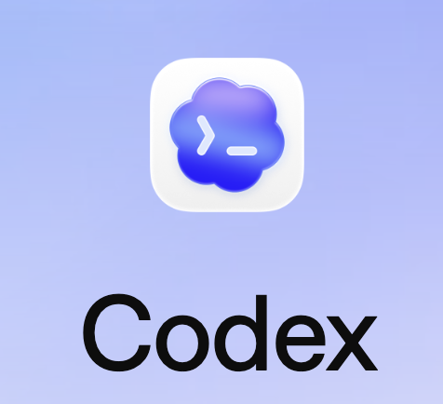


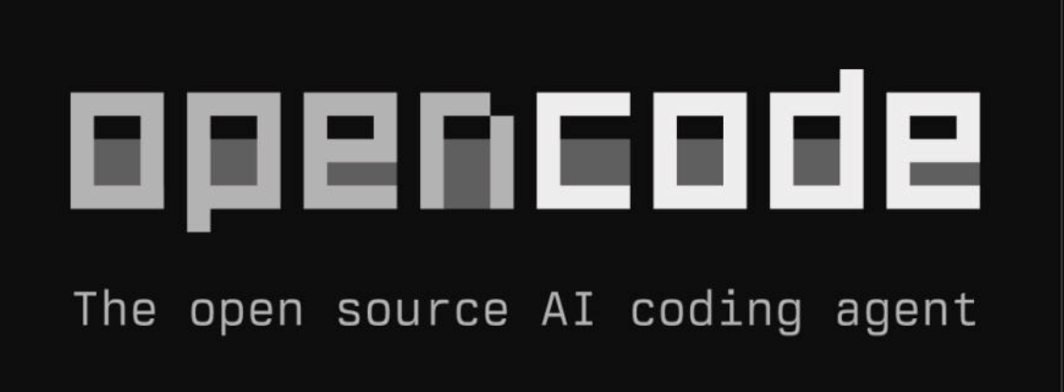
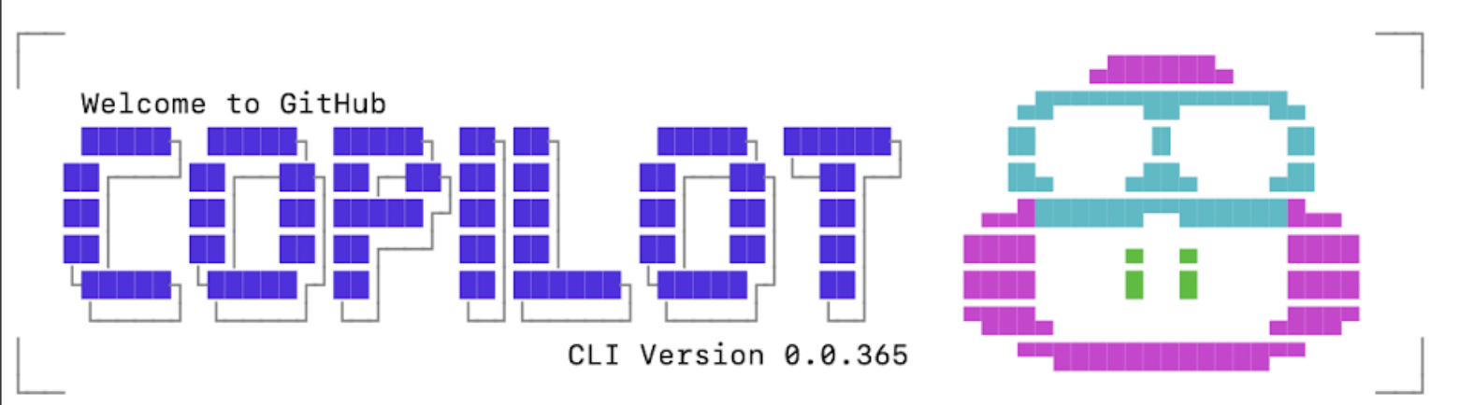
Some coding agents
Claude code
Hermes agent

Slide 3
€ € €
Some coding agents
Claude code
Hermes agent
Free educators licence

Slide 4
Coding agent = model + “coding harness”
Skills & MCP
Memory
AI model
Prompt & context engineering
Sub-agents

Slide 5
Coding harness: select AI model
Local Model (e.g. Gemma4)
Coding agent = thin client
API key (e.g. Gemini)
selector
Inference Provider
Inference providers are e.g. Nebius, runpod, Huggingface Hub etc

Slide 6
Coding agent = model + “coding harness”
Skills & MCP
Memory
AI model
Prompt & context engineering
Sub-agents

Slide 7
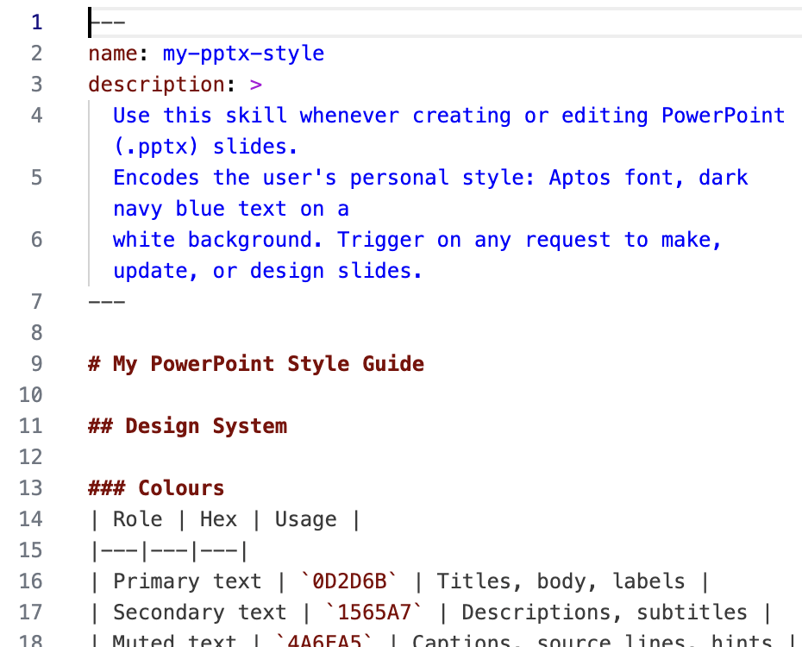
Give better instructions with Skills
Skills.MD is an open standard by Anthropic
It let’s you load a file that instructs the LLM what to do.
Most often used with Claude.
But it’s open source so you can run it with any coding agent.
Find skills at https://officialskills.sh/

Slide 8
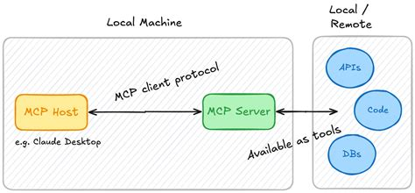
What is MCP
MCP (Model Context Protocol) is an open-source standard for connecting AI agents with external systems.
Using MCP AI agents can connect to data sources, tools and workflows.
Kind of like a specialized API language for agents!

Slide 9
MCP vs REST
REST is the right choice when:
You're building a service other developers or apps will consume
You want standard HTTP tooling (caching, auth, rate limiting, load balancing)
The consumer just needs data, not reasoning
MCP is best when:
- An LLM needs to decide which tool to call based on a user's natural language request
- You want one agent to expose capabilities to another agent
- You're building something where the set of available tools isn't known at code-write time

Slide 10
Coding agent = model + “coding harness”
Skills & MCP
Memory
AI model
Prompt & context engineering
Sub-agents

Slide 11
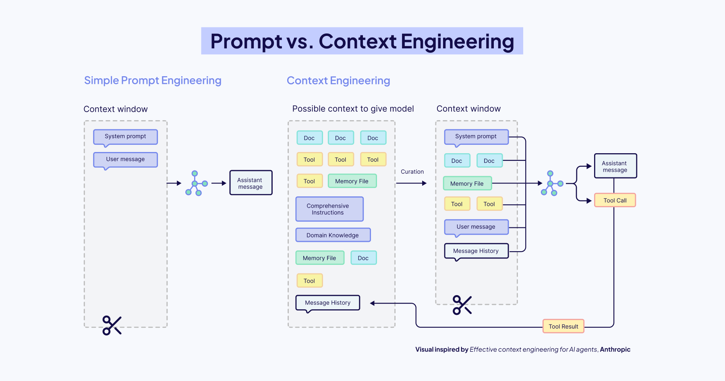
Prompt & context engineering
Prompt engineering: write better & longer prompts.
Context engineering: provide your model with the right context documents:
Architecture
Style guides
Patterns
Master data
Source: https://weaviate.io/blog/context-engineering

Slide 12
Coding agent = model + “coding harness”
Skills & MCP
Memory
AI model
Prompt & context engineering
Sub-agents

Slide 13



Three tiers of memory
The Coding Harness uses three distinct kinds of “memory” — only one of them actually learns.
Session state
Instructions
Memory
SHORT-TERM · LOCAL
DURABLE · AUTHORED
LEARNED · HOSTED
Everything from current session
AGENTS.md and .github/instructions/
Use from Skills
Deterministic config, not learned
Settings as SDD / TDD
Captured automatically as it works
Repo facts + user preferences
Validated; auto-expires after 28 days
Shared across CLI, cloud agent, review

Slide 14
Coding agent = model + “coding harness”
Skills & MCP
Memory
AI model
Prompt & context engineering
Sub-agents

Slide 15
Multi-agent systems
Example: city noise report pipeline — three agents, one task
Task:
"Measure background noise at 5 Amsterdam intersections and produce an ISO 9614 compliance report."
①
Planner
②
Worker
③
Verifier
Generates high-level tasks
Executes the tasks
Controls every result
RESPONSIBILITIES
RESPONSIBILITIES
RESPONSIBILITIES
Decompose goal into subtasks
Call measurement API per location
Check margin ≥ 3 dB per measurement
Assign locations & priorities
tasks →
Apply background subtraction formula
output →
Validate ISO 9614 format compliance
Set success criteria per task
Retrieve city noise ontology via MCP
Flag uncertain results for re-run
Sequence tasks & set timing
Write sections of the ISO report
Approve or reject each section
OUTPUT
OUTPUT
OUTPUT
Ordered task list with criteria
Measurements + draft report
Verified report or rejection + reason
← reject / replan
Pattern: Generator–Verifier (P1) nested in Orchestrator–Subagent (P2) · Verifier = vier-ogen principe — no result passes without independent review
Roles: Planner (orchestrator) · Worker (subagent) · Verifier (judge) · Ref: Feng, McDonald & Zhang (2025). Levels of Autonomy for AI Agents. arXiv:2506.12469

Slide 16
Summary
We have discussed the five most important elements of a ‘coding harness’”
AI model
Skills.md & MCP
Prompt engineering
Memory
Sub-agents
This presentation was just the first introduction to this subject.
Better coding harnesses will lead to better code. In the second half of 2026 we will see lot’s of improvements in coding harnesses. Watch this space.

